Slide 1
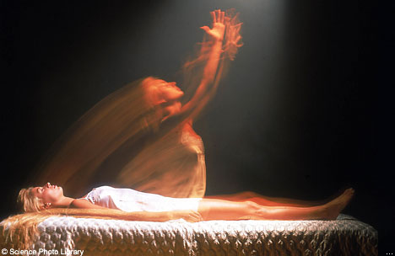
Out of Body Experiences
By Anna Zhu and Eric Wang
9/20/10

Slide 2
Out of Body Experiences Introduction
An out of body experience is the feeling when you leave your physical body and observe the world through your astral body which is a “heavenly” body. An out of body experience usually occurs when you are sleeping or when you are in a near death experience. An out of body experience is still a mystery because we do not know how it is possible for your astral body to see the world. Some people believe that out of body experiences aren’t real because they think that our souls cannot exit our body, even during an out of body experience.

Slide 3
Supporting Theories
Some neurologists believe that an out of body experience is caused by a mismatch between visual signals and tough signals. In one study, the subject used goggles to see his own body as how it would appear as a person standing behind him. The experimenter touched the subject the same time as a rod appeared to touch the image. This experiment caused the subject to believe that he was behind and outside his body. However, the experimenter and critics note that the study was less powerful than a real Out of Body Experience.
Another theory is that consciousness is separate from the body and can survive without one. The separated consciousness can hear, feel, taste, smell, and see. Some people speculate that the OBE is caused by brain states triggered by disease or stress, such as lack of sleep.

Slide 4
Opposing Theories
The skeptics say that Out of Body Experiences are merely hallucinations. During sleep paralysis, the body tries to send messages from the paralyzed muscles. For instance, the body might send the message that it is getting up now, and the person will actually feel as if he/she is rising. When this is prolonged, it becomes an "astral projection" or "out-of-body experience." Basically, it’s a trick of the brain. Skeptics also point to the increasing body of evidence that ties mental functions such as perception and memory to exclusively physical processes that occur in the brain; and note that no known mechanism would account for how these processes could occur at a distance. Also, there is no reliable evidence that any imagery or information acquired during the experience could not have come from normal sources. Out of Body Experiences cannot be disproved, but there is no solid evidence that anyone has actually left their body.

Slide 5
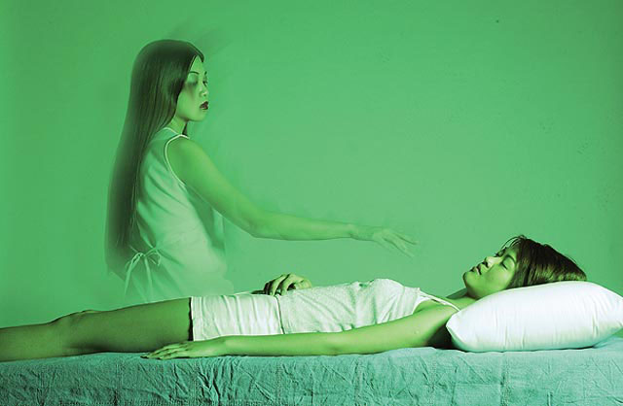
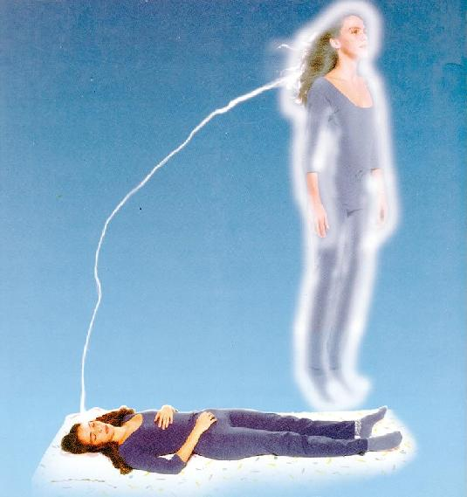
Evidence
A 45 year old blind woman experienced an OBE while being in surgery for a car accident. After the surgery, she said that she saw herself from another body, and then she described the surgery in so much detail that it looked like she saw it with her own eyes.
Charles A. Lindbergh, a famous pilot, said that on his first flight over the Atlantic Ocean, he felt himself rising out of his body and that body was outside of the plane, struggling to get in. He also said he saw a thin, silver cord attaching his “spirit” body to his real body.
A solo harpist said that he experienced an OBE while playing at a concert. He said that he saw himself playing on the stage, and a few moments later he returned to his body.

Slide 6
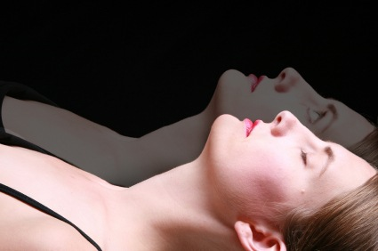
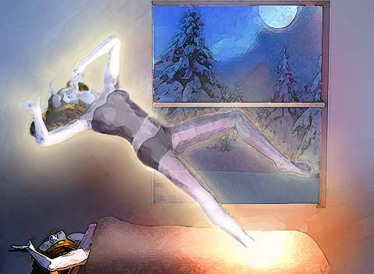
Conclusions
We believe that out of body experiences are not real. We think that it is just a trick our brain plays on us. There is also a lack of real evidence that proves that people really come out of their body. Our mind sends us signals, making feel like we are rising out of our body when we are actually not. Hallucinations that are like OBEs could be caused by stress, disease, or lack of sleep.

Slide 7
Credits (Bibliography)
harmer, mark. "Out of Body Experience in Front of an Audience." Archive X. N.p., 19july2010. Web. 22 Sep 2010. <http://www.wirenot.net/X/OOBEindex.shtml>.
Carroll, Thomas. "Out-of-body Experiences (OBE)." The Skeptic's Dictionary. N.p., 15072010. Web. 27 Sep 2010. <http://www.skepdic.com/obe.html>.
Hamilton-parker, Craig. "Out of Body Experiences- with Psychic Medium Craig Hamilton-Parker." Psychics and Mediums Network. Psychics & Mediums Network, n.d. Web. 27 Sep 2010. <http://www.psychics.co.uk/out-of-body-experiences/index.html>.
"Out of body experiences ( Astral projection ) – Mystery continues." New Age Thinkers. New Age Thinkers , n.d. Web. 27 Sep 2010. http://www.newagethinkers.com/my-thoughts/out-of-body-experiences-astral-projection-mystery-continues/.
ring, Kenneth. "People Born Blind Can See During a NDE." Dr. Kenneth Ring. N.p., 2010. Web. 27 Sep 2010. <http://www.near-death.com/experiences/evidence03.html>.

